Slide 1
CORBA - EJB
Service-oriented Architecture
Vo Dinh Hieu

Slide 2
Contents
Common Object Request Broker Architecture
Enterprise JavaBeans

Slide 3

The needs
C++
interaction
Java
Windows
Unix
Notes:
Các ứng dụng trong hệ thống được phát triển độc lập
Triển khai trên các máy khác nhau

Slide 4
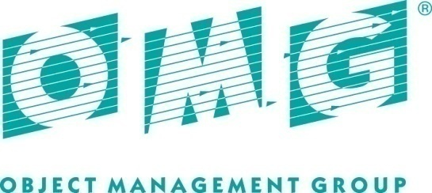
OMG
Object Management Group
A group of vendors who jointly developed a common way to interact with distributed objects
Founded: 1989 by twelve commercial vendors: IBM, BNR Europe Ltd., Expersoft Corp., ICL plc, Iona Technologies Ltd., DEC, Hewlett-Packard, HyperDesk Corp., NCR,…
More than 800 members now

Slide 5
CORBA
CORBA: Common Object Request Broker Architecture
A standard developed by OMG for distributed objects programming (a specification, not a programming language)
CORBA is based on Object Management Architecture (OMA)

Slide 6
Object Request Broker
The software that implemented CORBA specification
A complex RPC middleware
The heart of CORBA, responsible for
Finding object implementation for the request
Prepare object implementation to receive the request
Communicate the data make up the request
Products: VisiBroker, ORBIX, JavaIDL

Slide 7
CORBA allows applications to communicate
On different computers, for example, across a network.
On different operating systems. CORBA products are available for many operating systems, including Windows, UNIX, IBM mainframes and embedded systems.
On different CPU types, for example, Intel, SPARC, PowerPC, bigendian or little-endian, and different word sizes, for example, 32-bit and 64-bit CPUs.
Implemented with different programming languages, such as, C, C++, Java, Smalltalk, Ada, COBOL, PL/I, LISP, Python and IDLScript

Slide 8
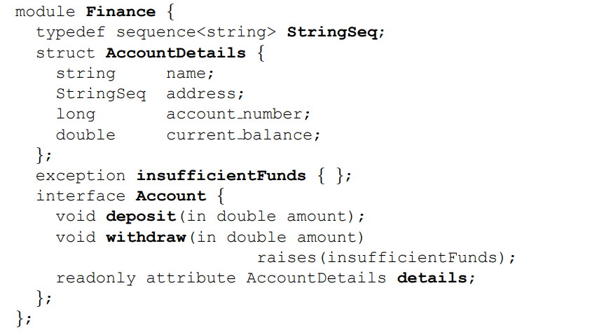
Interface Definition Language
IDL
IDL defines API of object
IDL supports multiple inheritance

Slide 9
Interface Definition Language
IDL compiler: translate an IDL to language-specific stubs and skeletons
CORBA provides mappings from IDL to specific programming languages (such as C++, Java, Python,…)

Slide 10
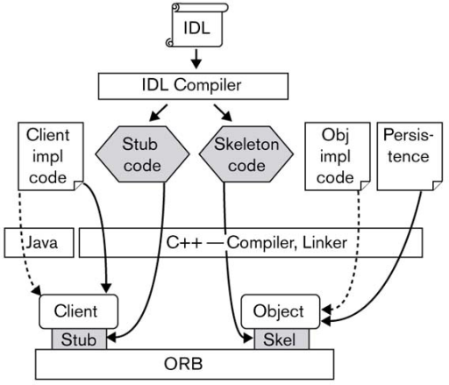

Slide 11
Dynamic Invocation
Dynamic Invocation Interface (DII): supports dynamic client request invocation
Dynamic Skeleton Interface (DSI): provides dynamic request dispatching to the implementation objects.

Slide 12
Object Adapter
Object Adapter provides an intermediate layer between the object implementation and the ORB Core
The OA is responsible for the following operations:
Object reference handling: Object references are created in servers. Once they have been created, they may be exported to clients. From this model’s perspective, object references encapsulate object identity information and information required by the ORB to identify and locate the server and OA with which the object is associated.
Object request transportation: When a client issues a request, the ORB first locates an appropriate server and then locates the appropriate OA within that server. Once the ORB has found the appropriate OA, it delivers the request to that OA. Then the OA invokes the appropriate method on the request’s target object.

Slide 13
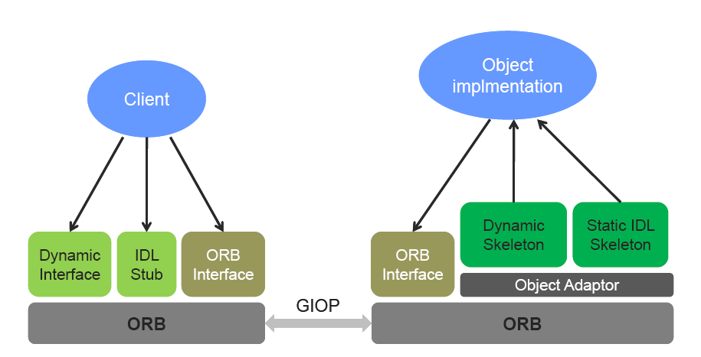
CORBA
Object Implementation

Slide 14
Object Management Architecture
Banking,
Healthcare, etc.
Application
Objects
Vertical
CORBA Facilities
Horizontal
CORBA Facilities
Object Request Broker
User Interface,
System management,
Task management, etc.
Naming,
Trading,
Event, etc.
CORBA Services

Slide 15
Java Enterprise Edition
For developing enterprise applications
Enterprise applications provide the business logic for an enterprise
The business and presentation logic to be implemented by the developer
The standard system services provided by the Java EE platform
JCP: Java Community Process
JSR: Java Specification Requests
Notes:
the need for distributed, transactional, and portable applications that leverage the speed, security, and reliability of server-side

Slide 16
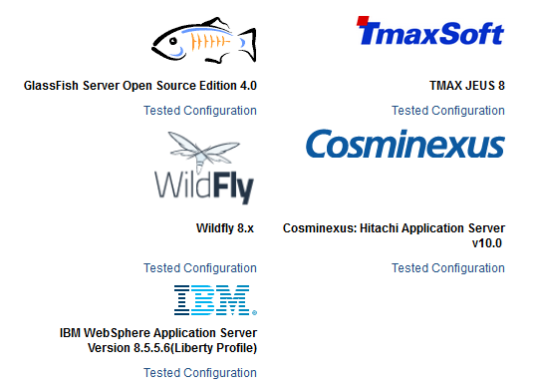
Java EE Compatibility

Slide 17
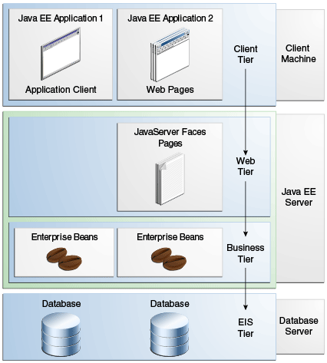
Distributed Multitiered Applications

Slide 18
Java EE Components
A Java EE component is a self-contained functional software unit that is assembled into a Java EE application
EE component can communicate with other components
Type of components
Application clients and applets are components that run on the client.
Java Servlet, JavaServer Faces, and JavaServer Pages (JSP) technology components are web components that run on the server.
EJB components (enterprise beans) are business components that run on the server.

Slide 19
Java EE Clients
A Java EE client is usually either a web client or an application client.
A web client consists of two parts:
Dynamic web pages containing various types of markup language (HTML, XML, and so on), which are generated by web components running in the web tier
A web browser, which renders the pages received from the server

Slide 20
Java EE Clients
Application Clients
Provides a way for users to handle tasks that require a richer user.
An application client typically has a graphical user interface (GUI) created from the Swing API or the Abstract Window Toolkit (AWT) API
Application clients directly access enterprise beans running in the business tier.
Application clients can open an HTTP connection to establish communication with a servlet running in the web tier
Notes:
, but a command-line interface is certainly possible.

Slide 21
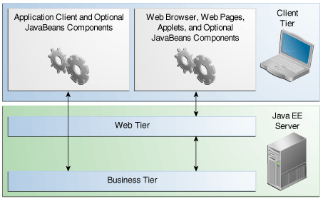
Java EE Server Communications

Slide 22
Web Components
Java EE web components are either servlets or web pages created using JavaServer Faces technology and/or JSP technology
Static HTML pages and applets are bundled with web components during application assembly but are not considered web components by the Java EE specification

Slide 23
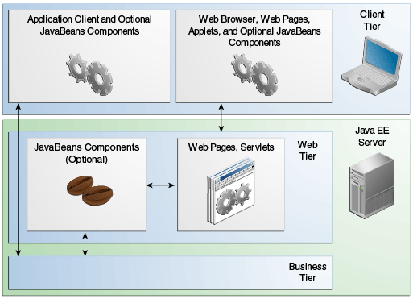

Slide 24
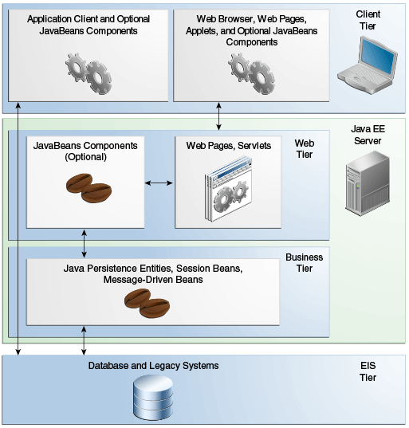
Business Components

Slide 25
Java EE Server and Containers
The server and containers are as follows:
Java EE server: The runtime portion of a Java EE product. A Java EE server provides EJB and web containers.
EJB container: Manages the execution of enterprise beans for Java EE applications. Enterprise beans and their container run on the Java EE server.
Web container: Manages the execution of web pages, servlets, and some EJB components for Java EE applications. Web components and their container run on the Java EE server.
Application client container: Manages the execution of application client components. Application clients and their container run on the client.
Applet container: Manages the execution of applets. Consists of a web browser and a Java Plug-in running on the client together.

Slide 26
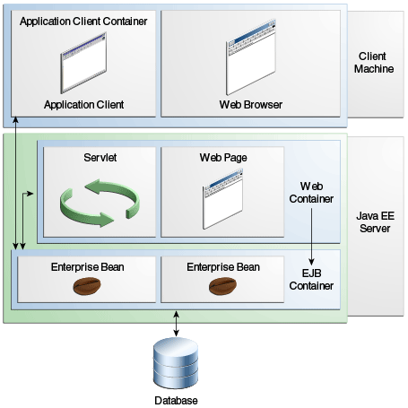
Java EE Server and Containers

Slide 27
Enterprise JavaBeans
An enterprise bean is a server-side component that encapsulates the business logic of an application
The business logic is the code that fulfills the purpose of the application

Slide 28
Why EJB?
EJB container provides system-level services to enterprise beans, the bean developer can concentrate on solving business problems. The EJB containeris responsible for system-level services, such as transaction management and security authorization.
The beans contain the application's business logic, the client developer can focus on the presentation of the client. As a result, the clients are thinner, a benefit that is particularly important for clients that run on small devices.
Enterprise beans are portable components, the application assembler can build new applications from existing beans.

Slide 29
Type of EJBs
Session Bean: Performs a task for a client; optionally, may implement a web service
Message-Driven Bean: Acts as a listener for a particular messaging type, such as the Java Message Service API

Slide 30
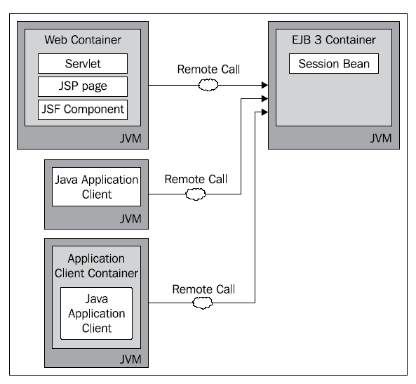
EJB Architecture

Slide 31
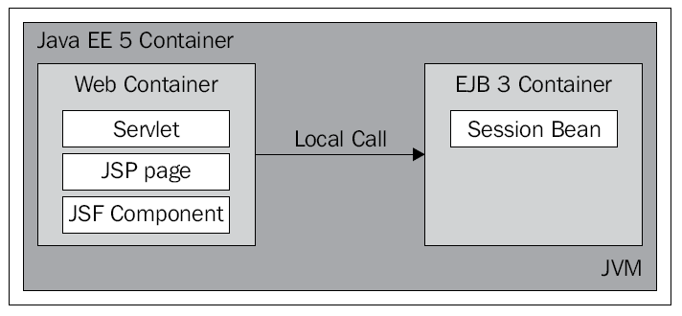
EJB Architecture

Slide 32
Session Bean
Stateless: the state is not maintained between invocations
Stateful: requests from a client are ensured to reach the same bean instance
Singleton: A singleton session bean is instantiated once per application and exists for the lifecycle of the application

Slide 33
Stateless vs. Stateful
5
3
request
request
2
1
ID = 5
random selection
Select by ID
4
6
7
Instance pool
Instance cache
EJB container
EJB container
Stateless Bean
Stateful Bean

Slide 34
Message-driven Bean
Realize the concept of messaging
The motivation of messaging
Asynchrony: clients do not have to wait why server is processing
Decouple: client do not have to know the server
Reliability: if server crashes, client might receive the result a bit late, but the invocation is still successful
Multiple senders and receivers

Slide 35
Messaging style
Publish/Subscribe
Producer 1
Consumer 1
Topic
Producer 2
Consumer 2
Point-to-Point
Producer 1
Queue
Consumer
Producer 2

